Slide 1
Drowsiness Detection System
By –
Pratiksha Manjrekar (31)
Omkar Pednekar (42)
Under Guidance of – Prof. Sudeshna Roy
Bharati Vidyapeeth Institute of Management and Information Technology

Slide 2
Context & Problem statement
With the rise in population, the occurrence of road accidents has been increasing.
A recent study showed that, around half million accidents occur in a year, in India itself. Out of which 60% of these accidents are caused due to Driver’s Drowsiness.
To develop a system that can automatically detect and perform appropriate immediate reaction based on different level of drowsiness.
Detection in real-time is the major challenge in the field of accident prevention system.
Our aim is to provide a Driver Drowsiness Detection System, which will alert not only the driver but also the co-passengers with a loud alarm in the car.
For that we will be using face tracking and video processing.

Slide 3
Literature Review
One of the major cause of traffic accident is Driver‘s drowsiness. It is a serious highway safety problem.
If drivers could be warned before they became too drowsy to drive safely, some of these crashes could be prevented.
In order to reliably detect the drowsiness, it depends on the presentation of timely warnings of drowsiness.
To date, the effectiveness of drowsiness detection methods has been limited by their failure to consider individual differences.
Based on the type of data used, drowsiness detection can be conveniently separated into the two categories of intrusive and non-intrusive methods.
During the survey, non-intrusive methods detect drowsiness by measuring driving behavior and sometimes eye features, through which camera based detection system is the best method and so are useful for real world driving situations.

Slide 4
Proposed Solution & Novelty
A driver drowsiness system can be designed to monitor the behaviour and alertness of a driver while they are operating a vehicle.
Based on the previous research, there is no one who used histogram for analysis.
The result cannot be accurate because histogram analysis analysed the whole image.
This project is to develop a driver drowsiness detection system by using histogram analysis.
Eye tracking: The system can use a camera to track the movements of the driver's eyes. If the driver's gaze becomes fixed or their eyes start to close for extended periods of time, it can trigger an alert to the driver to wake them up or take a break.
Facial recognition: The system can use a camera to analyze the driver's facial expressions and determine if they are drowsy or distracted. If the system detects that the driver is showing signs of drowsiness, it can trigger an alert.

Slide 5
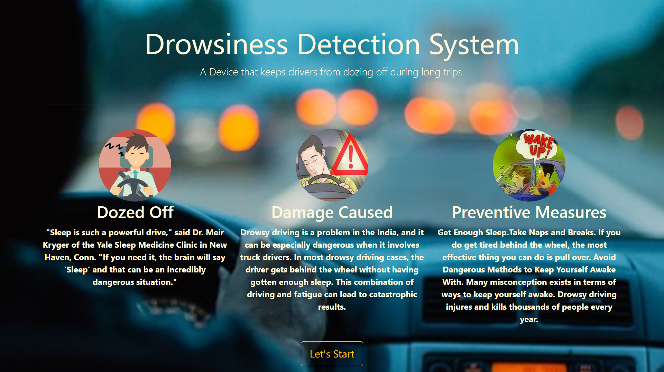
Methodology & Implementation
A Website for our system build on Flask Server

Slide 6
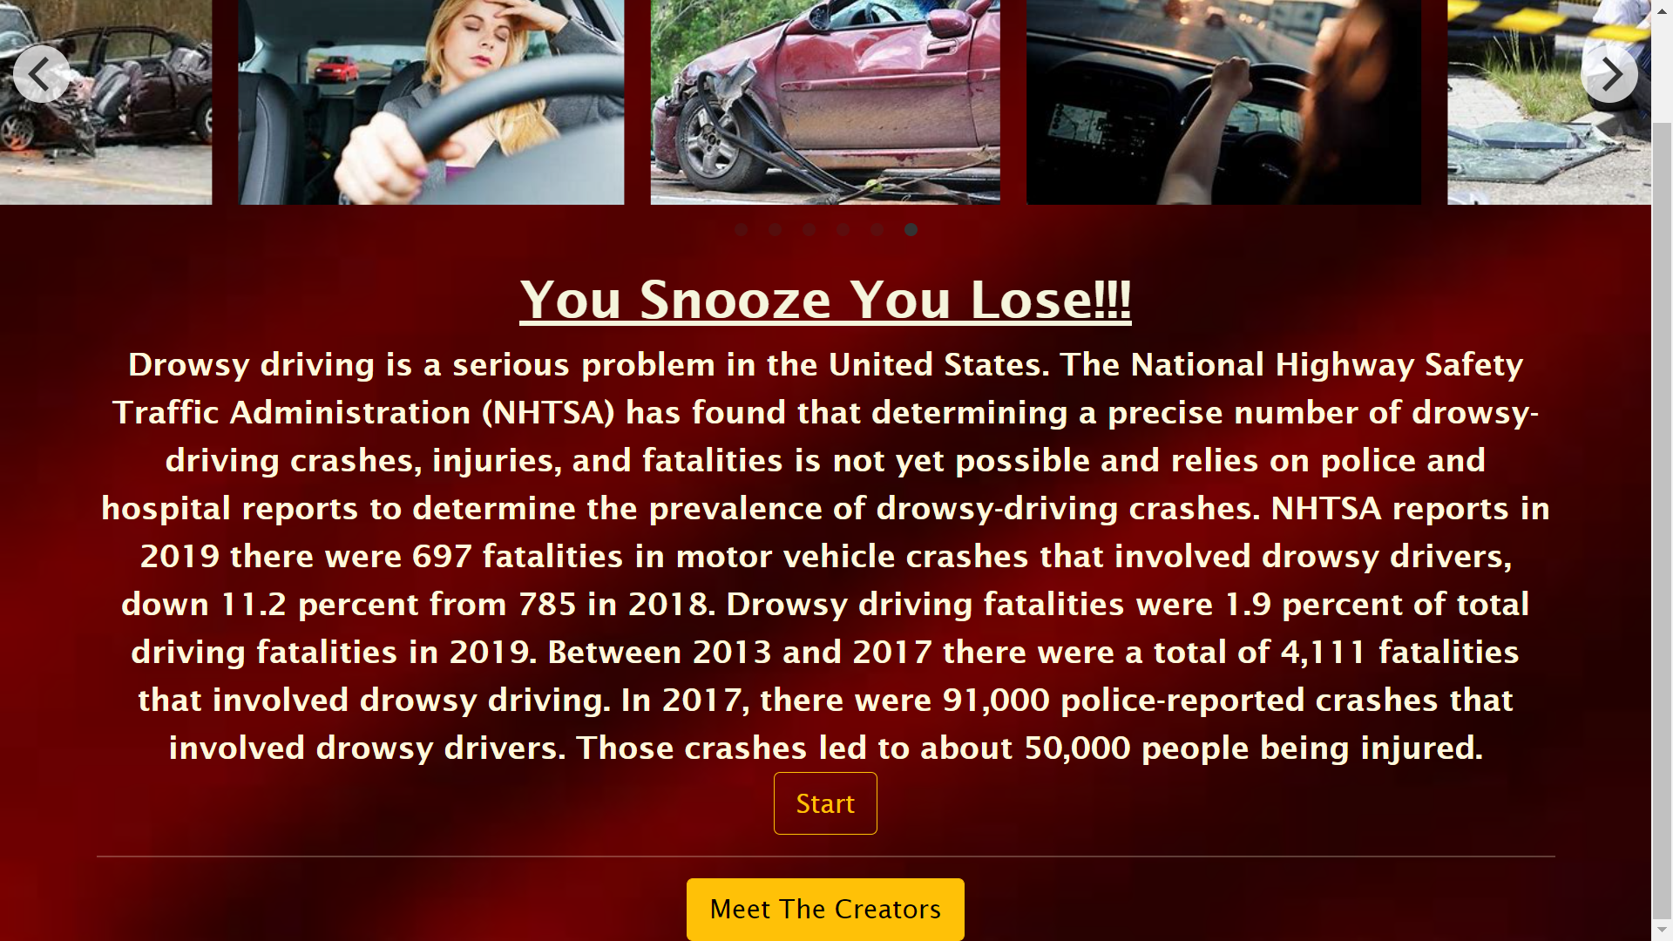
Methodology and Implementation

Slide 7
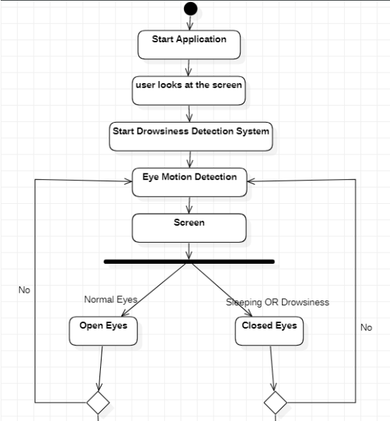
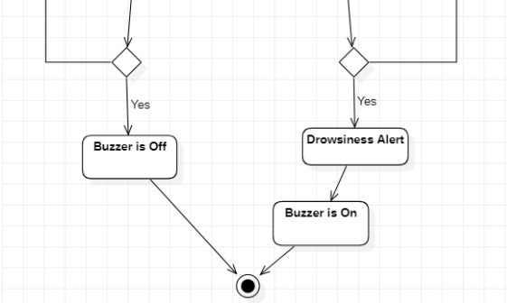
Methodology & Implementation

Slide 8
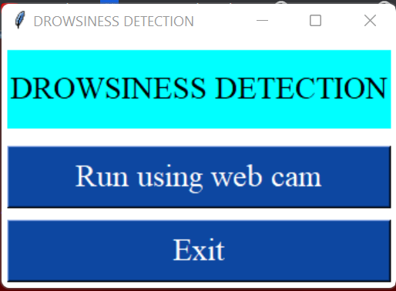
Methodology and Implementation
Select on the camera you want work with.
For this we use Tkinter (Python)

Slide 9
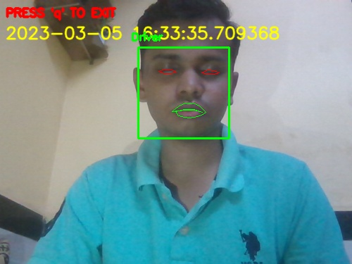
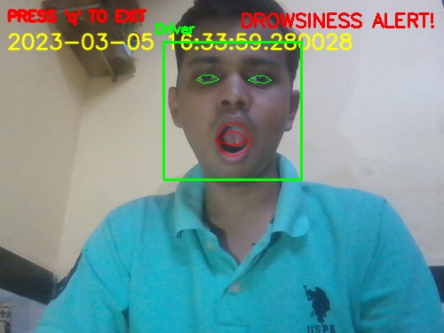
Checking if Drowsy?

Slide 10
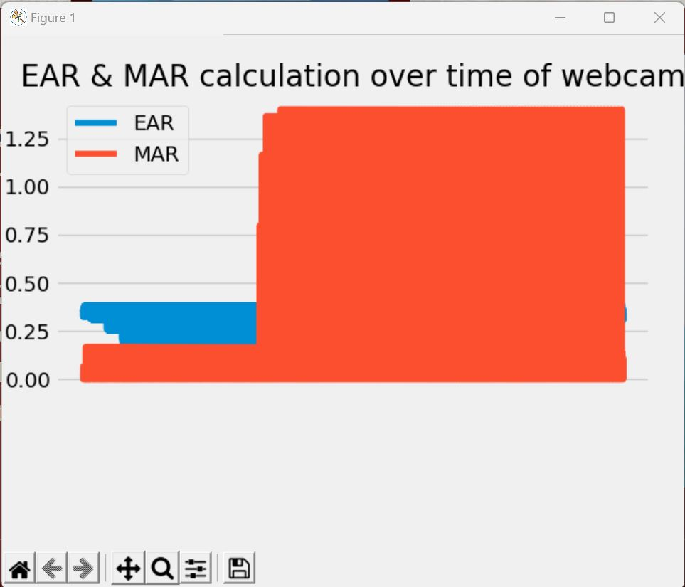
Histogram

Slide 11
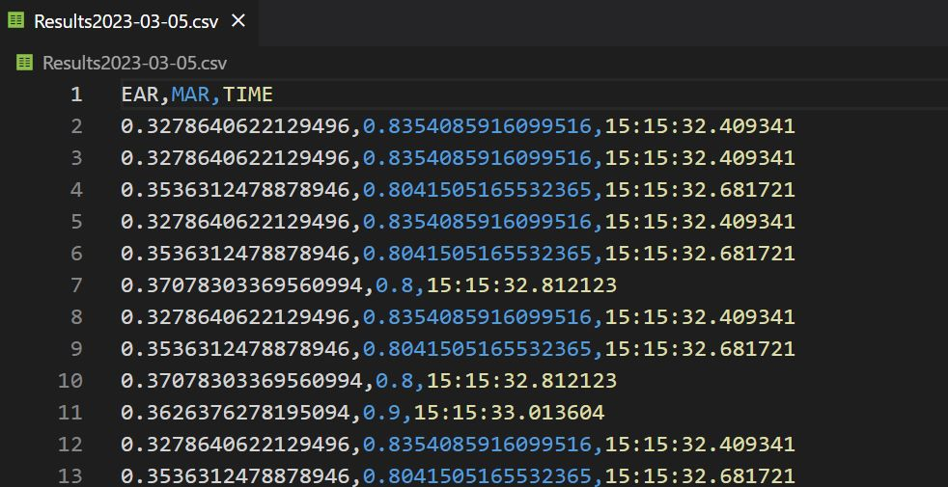
CSV File Created

Slide 12
Results and future plans
It completely meets the objectives and requirements of the system.
Our objective of the project is to ensure the safety system.
We plan to further work on the project by adding a sensor to track the heart rate in order to prevent accidents caused due to sudden heart attacks to drivers.
We can improve the system by adding the contact of the individual to whom the driver can call the person if some accident occurs.
In this eye blink sensor, we can add other sensor like alcohol sensor, sending location of vehicle if accident occur.

Slide 13
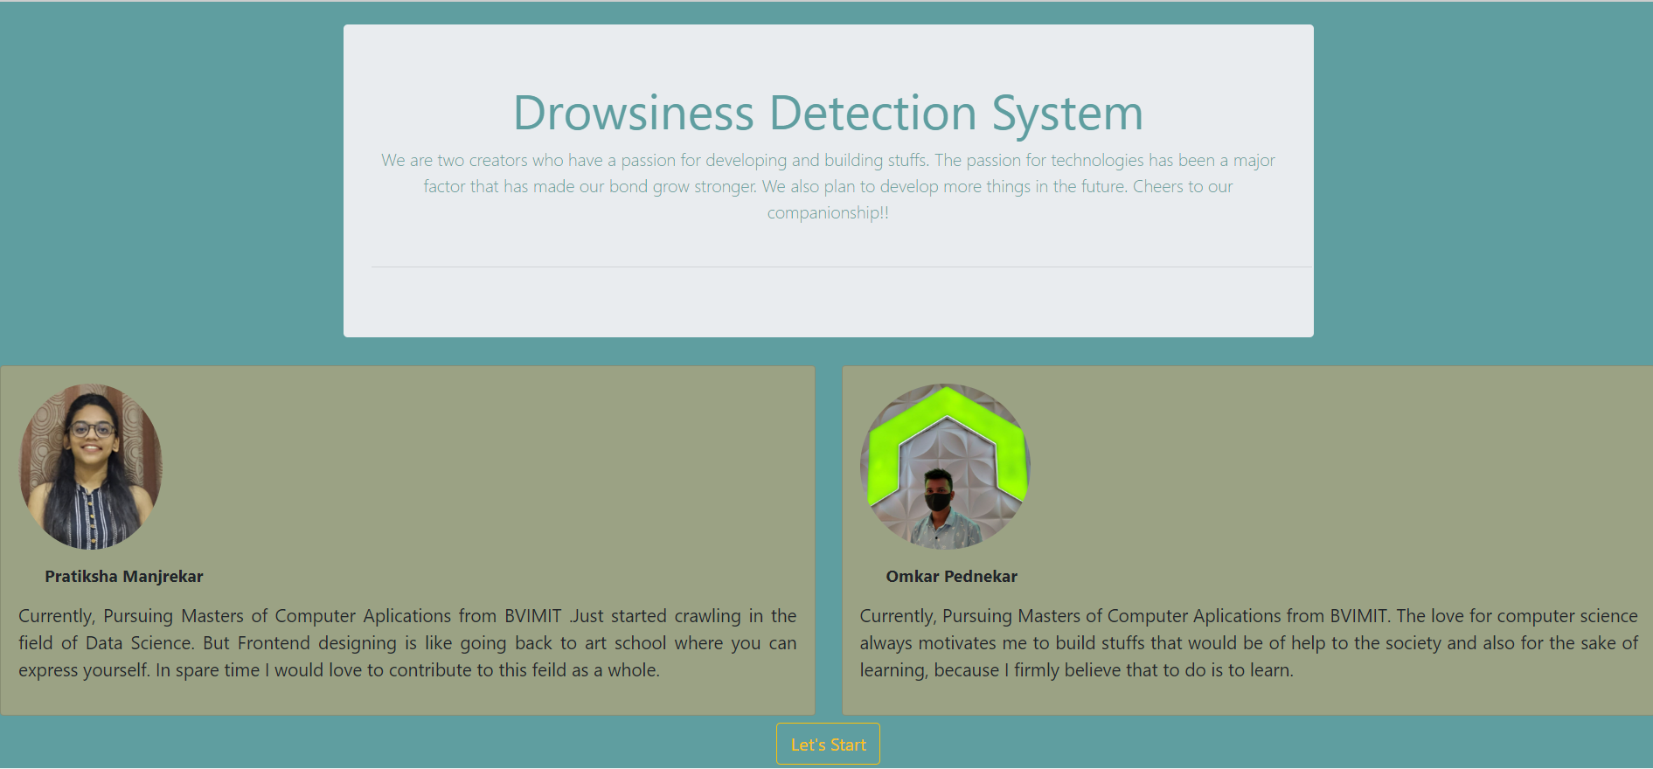
User’s Tab

Slide 14
THANK YOU

